Slide 1
Level 6 Group 4

Slide 2
The brief
Game of Emergence
Multiple solutions
Single Player
PC

Slide 3
Demographic / Psychographic
Males
Aged 15-25
Students
Management / City simulation game

Slide 4
What the player does
Manage population
Select monster to hunt
Grow city
Upgrade units

Slide 5
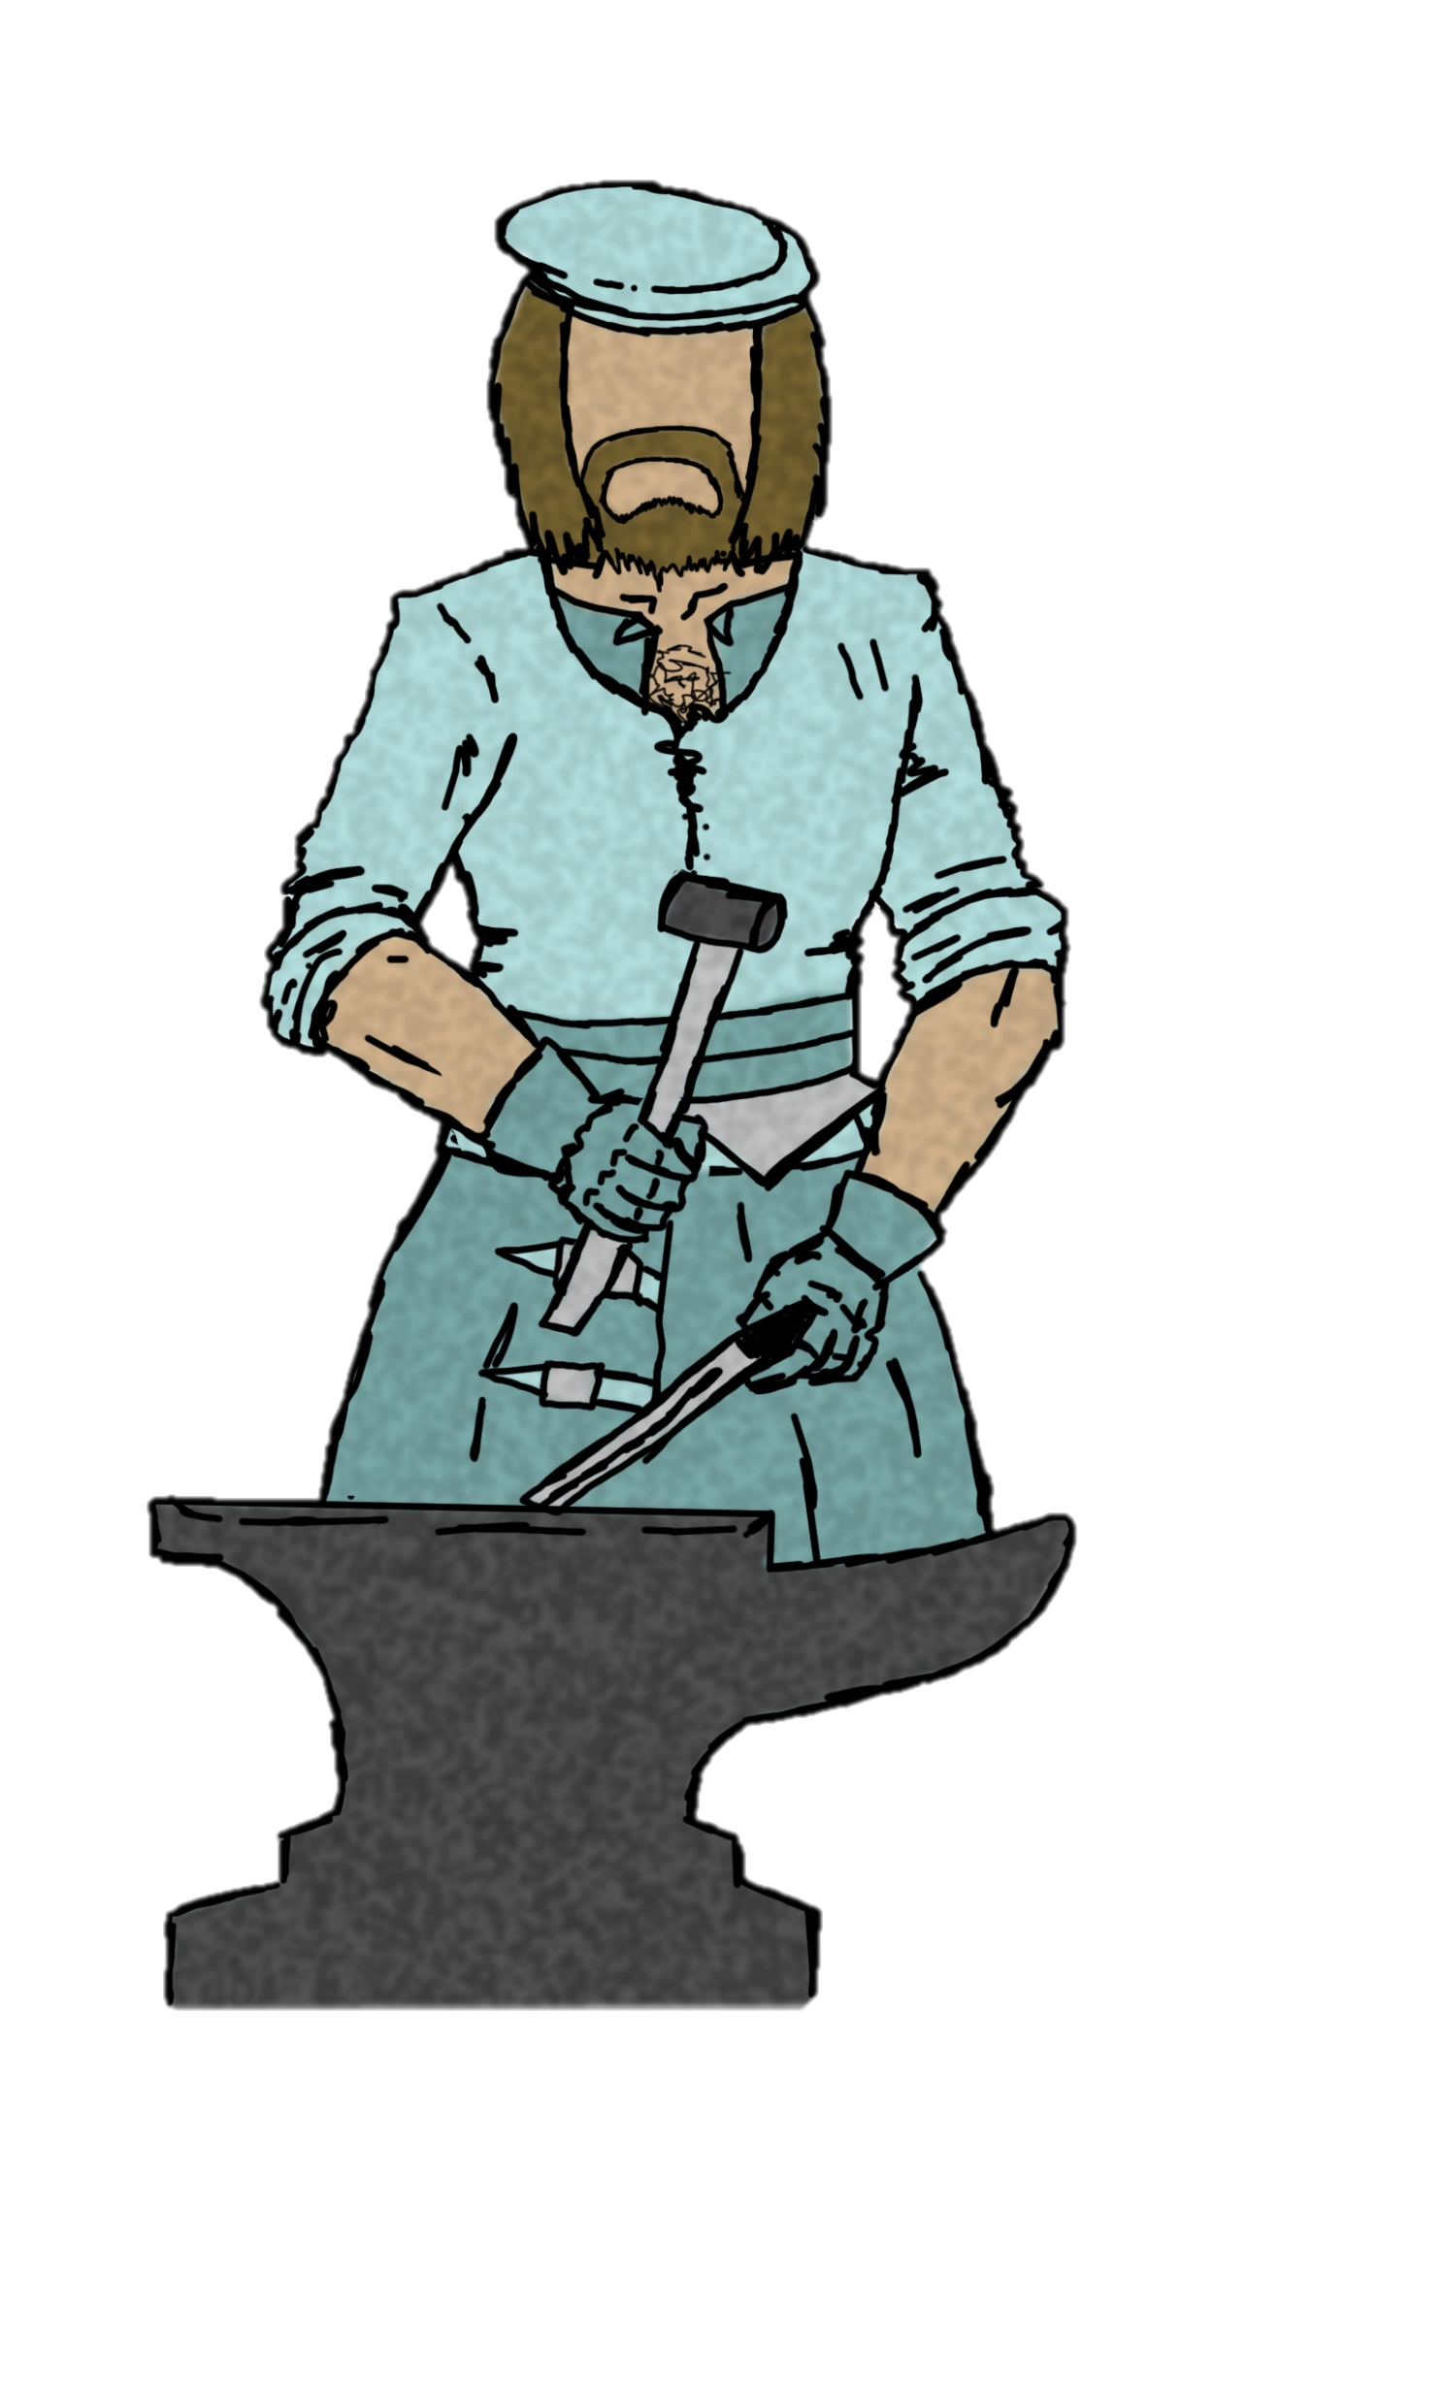
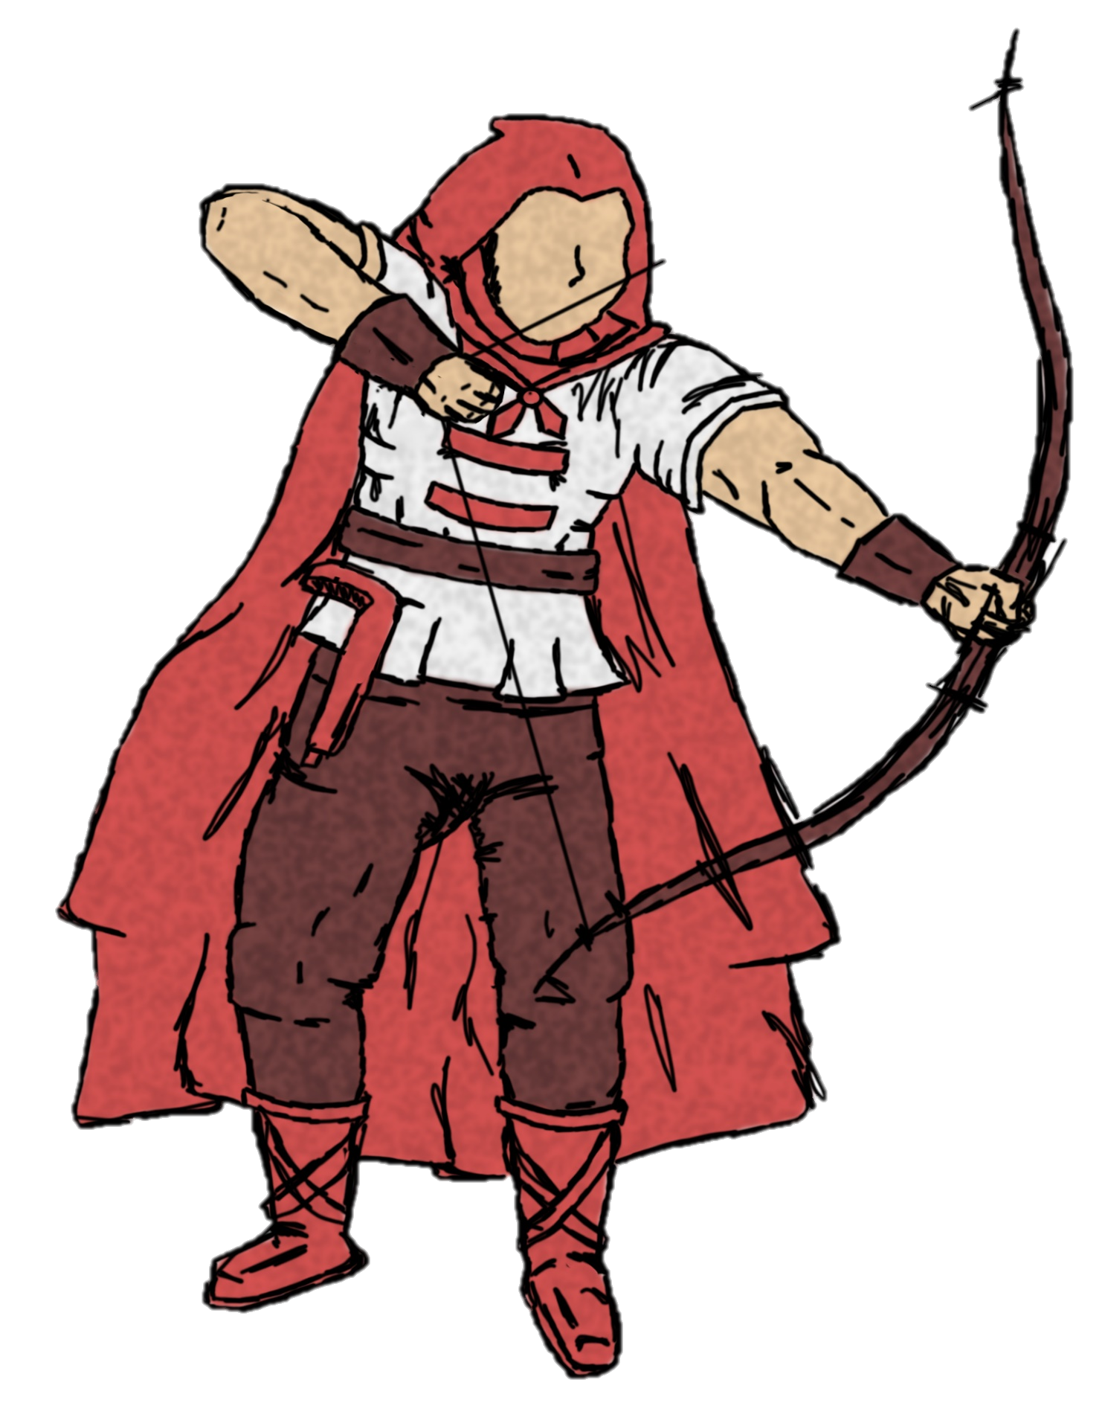
Colonists
Hunters
Scout
Blacksmith (POSSIBLY CRAFTER)
Farmer

Slide 6
Main Game loop
[insert vidya]

Slide 7
Returning Player [working title]
Attachment to town
Emergent story

Slide 8
Art Assets (Colonists)

Slide 9
Art Assets (Monsters)

Slide 10
Questions?

